Slide 1
Problem Solving
Problem Solving and Computational Thinking

Slide 2
Let’s get started…
Consider the following question:
What is a computer program?

Slide 3
Let’s get started…
Consider the following question:
What is a computer program?
A program is a description in a programming language of a process that achieves some result that is useful to someone.¹
Computer programming is problem solving.

Slide 4
Puzzle
Working in pairs you have 10 minutes to solve the logic puzzle.
You need to show two methods in which the problem could be solved.
You have 10 minutes – go!

Slide 5
Answer …

Slide 6

Farmer takes Goat across (leaving Wolf and Cabbage behind)
Farmer returns alone
Farmer takes Wolf across
Farmer returns with Goat
We now have the Farmer, the Cabbage and the Goat on one side and the Wolf on the other side
Farmer takes Cabbage across
Farmer returns alone
Farmer takes Goat across

Slide 7
Problem Solving & Computer Programming
The purpose of writing a computer program is to solve a problem.
If a problem does not exist, then the computer program is not required.
What problem(s) did/do the following programs solve:
Apple iTunes
Microsoft Outlook
Android Pay

Slide 8
Python
Python will be the main language used for this module.
No only is it an excellent teaching language, it is heavily used in industry for:
Web programming
Network programming
Data Science – machine learning and artificial intelligence
Although it has a very basic interface, don’t fall in to the trap of thinking it is a lesser language!
Multi-platform
E.g. write in Mac run in Windows

Slide 9
Hands on with Python
IDE
repl.it – my preferred IDE

Slide 10
Modelling
Hello world
a + b
a * b
VAT
Discuss: + - / *
User enter text
Add / concatenate
Cast to int
Cast to float

Slide 11
Variables
Variables are used to store data
The data is stored in main computer memory
RAM
Think of them as containers that temporarily hold data.
Variables can be modified in a program
Each variable has a unique identifier (name)

Slide 12
Data Types
Variables can store different types of data
Text
Numeric
Different languages can also handle variations of data types
Numeric : integers
Numeric : real numbers

Slide 13
Program Sequence
The code we have written so far is sequential…
…it is executed line by line.
Each complete line of code is called a program statement.
Sequence is one of three core programming concepts
Selection
Iteration

Slide 14
Comments
Programming languages allow developers to include notes in their code.
The comments are ignored by the compiler/interpreter.
Very import feature
For your studies they prove understanding of code – use them a lot!
In industry they help colleagues/fellow developers.
For your assignments, use plenty of comments in your code
Better to go “over the top” – proves you understand the code.
Python comments:
# for single line
""" for multi-line

Slide 15
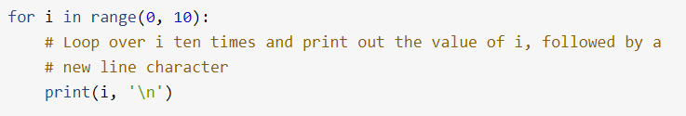
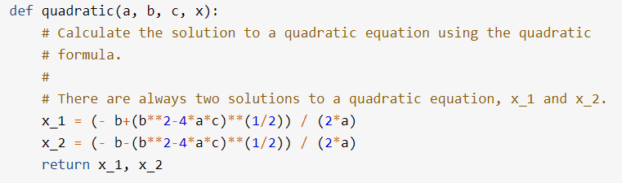
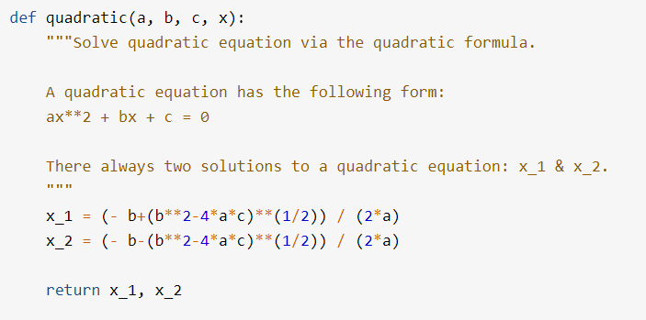

Documentation strings, or docstrings, are strings enclosed in double (""") or single (''') quotation marks that appear on the first line of any function, class, method, or module. You can use them to explain and document a specific block of code.

Slide 16
Questions
Any questions about the programming concepts we have looked at today?

Slide 17
Activities and practice
Create a program that allows the user to enter two numbers, subtracts them and writes out the answer
Create a program as above that multiplies two numbers
Create a program as above which, adds, subtracts, multiples two numbers and writes out all the answers
Create a program that allows the user to enter two numbers, divides them and writes out the answer
Create a program that allows the user to enter 4 different numbers and works out the average

